Slide 1

Exam AZ-305: Designing Azure Infrastructure Solutions Crash Course
Tim Warner

Slide 2

Tim Warner
Based in Nashville, TN, US
28-year Microsoft Certified Trainer (MCT)
6-year Microsoft MVP in Azure AI
Contact: TechTrainerTim.com

Slide 3
Agenda
5 segments covering all AZ-305 exam objectives
Identity, Data Storage, Business Continuity, Infrastructure
Aligned with October 2024 exam update
Hands-on demos throughout each segment
Well-Architected Framework principles woven throughout

Slide 4
Break Schedule (Central Time)
09:00 am - Start Segment 1 (Identity, Governance, Monitoring)
10:00 am - 9-min break - Start Segment 2 (Data Storage Solutions)
11:00 am - 9-min Break - Start Segment 3 (Business Continuity)
12:00 pm - 9-min Break - Start Segment 4 (Infrastructure Solutions)
01:00 pm - 9-min Break - Start Segment 5 (Network Solutions)
1:50 PM - Course Complete

Slide 5
Course Materials
timw.info/az305

Slide 6
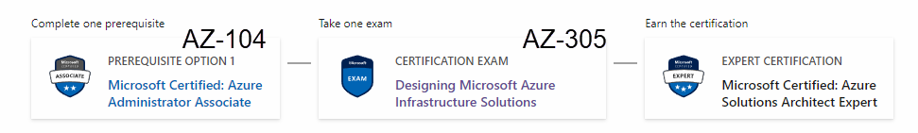
Azure Solutions Architect Expert
One-year validity

Slide 7
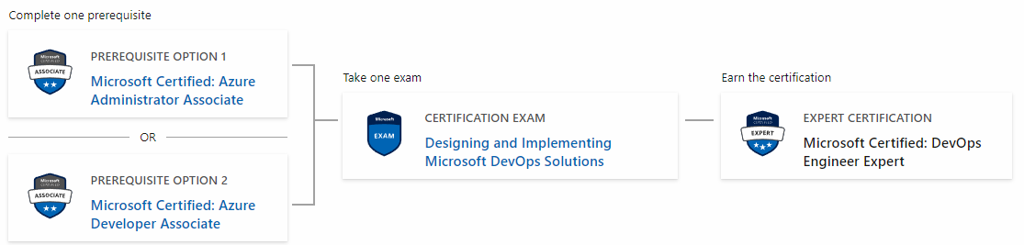
Microsoft DevOps Engineer Expert
AZ-104
AZ-400
AZ-204

Slide 8
Recommended Next Steps
Review this course's companion repo
Practice with Azure free tier or sandbox
Take the official practice assessment
Schedule your exam within 2 weeks
Good luck on your certification journey!

Slide 9
Thank you!
Course materials: timw.info/az305
Contact: TechTrainerTim.com

Slide 10
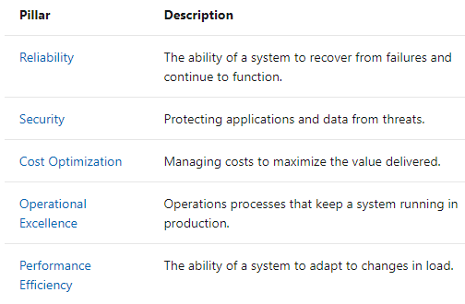
Segment 1: Identity, Governance & Monitoring

Slide 11
Segment 1 Learning Objectives
Design solutions for logging and monitoring
Design authentication and authorization solutions
Design governance
Recommend identity management solutions
Recommend solutions to manage secrets, certificates, and keys

Slide 12

Log Analytics

Slide 13

Sentinel

Slide 14
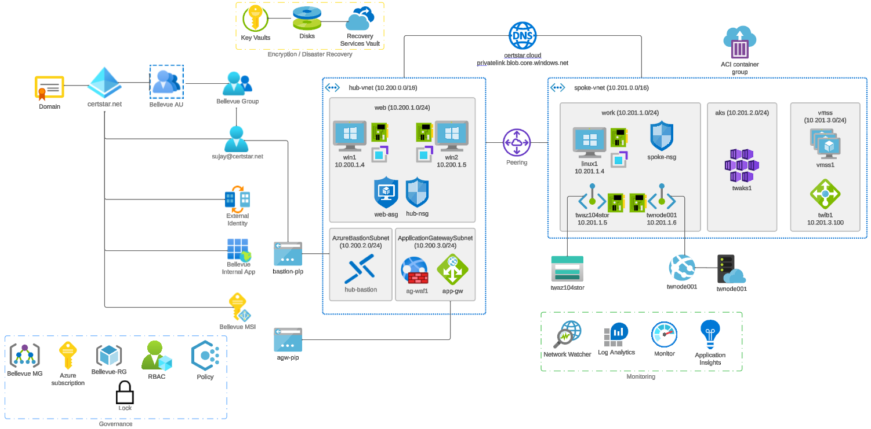


Slide 15

Hybrid Identity

Slide 16

Azure AD B2C

Slide 17
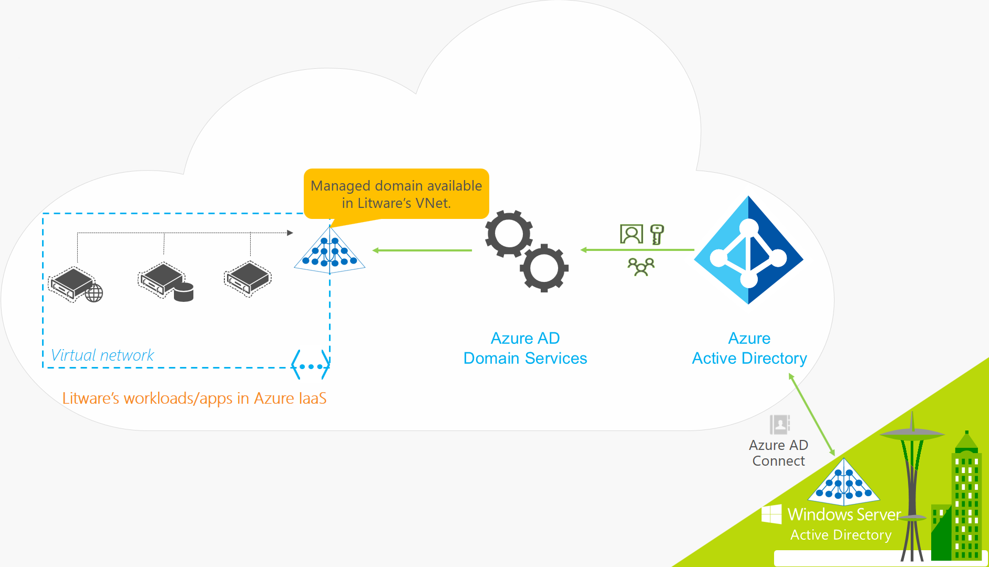
Azure AD Domain Services

Slide 18

Seamless Single Sign-on

Slide 19

Azure Management Scopes
/ Tenant Root

Slide 20
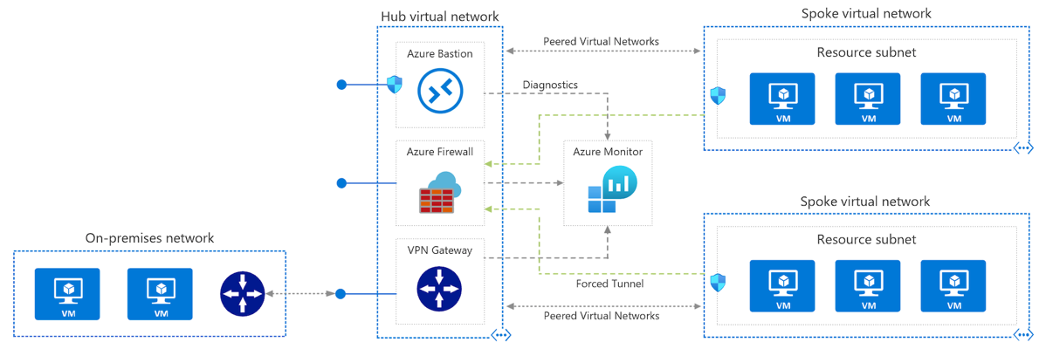
Azure VNet Hub-Spoke

Slide 21
RBAC Deep Dive
Built-in vs. custom roles
Deny assignments and scope inheritance
Management group scope for multi-subscription
NotActions vs. deny assignments
Testing with What If in portal

Slide 22
Azure Policy
Policy effects: Deny, Audit, Modify, DeployIfNotExists
Initiatives vs. individual policies
Exemptions and compliance remediation
CIS benchmark deployment
Compliance dashboard and reporting

Slide 23
Key Vault Patterns
RBAC vs. access policies
Soft delete and purge protection
Managed identity access patterns
Secret rotation with Event Grid
Key Vault Premium for HSM-backed keys

Slide 24
Exam Tips - Segment 1
RBAC scope: multiple subscriptions = management group
Log Analytics: 30 days free, 730 max, archive tier
Key Vault: compliance = purge protection
Entra B2B = partners, B2C = consumers
PIM = JIT elevation, Access Reviews = attestation

Slide 25
Segment 2: Data Storage Solutions

Slide 26
Segment 2 Learning Objectives
Design data storage solutions for relational data
Design solutions for semi-structured and unstructured data
Design data integration
Recommend database service and compute tiers
Recommend solutions for data protection and durability

Slide 27
SQL Database Decision Tree
SQL Database: Managed PaaS, easy scaling
SQL MI: Near 100% SQL Server compatibility, requires VNet
SQL on VM: Full control, complex licensing
PostgreSQL/MySQL Flexible Server: Open source options
Choose based on compatibility and management needs

Slide 28
Service Tier Selection
DTU: Bundled compute/storage, simpler pricing
vCore: Reserved capacity, hybrid benefit eligible
Serverless: Auto-pause, pay-per-second
Provisioned: Predictable workloads, consistent perf
Elastic pools: Shared resources for multiple DBs

Slide 29
Cosmos DB Partition Strategy
Partition key: High cardinality, even distribution
RU estimation: Size x ops/sec x complexity
Global distribution: Multi-region writes
Consistency: Strong to Eventual spectrum
Analytical store: HTAP without ETL

Slide 30
Storage Account Replication
3
3
GRS/RA-GRS

Slide 31
Storage Account Replication
3
3
GRS/RA-GRS

Slide 32
Storage Account Replication
1
3
1
3
2
2
GZRS – RA/GZRS

Slide 33

Always Encrypted

Slide 34
Data Lake Design Patterns
Data Lake Storage Gen2: Hierarchical namespace
Bronze/Silver/Gold zones (medallion architecture)
ACLs for fine-grained access control
Integration with Synapse and Databricks
Lifecycle management for cost optimization

Slide 35

Event Architecture

Slide 36
Storage Account Replication
1
3
3
2
LRS
ZRS

Slide 37
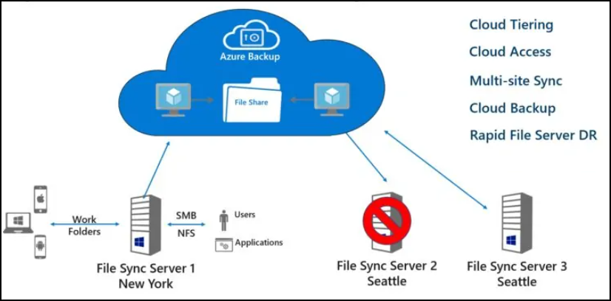
Azure File Sync

Slide 38
Exam Tips - Segment 2
SQL MI vs SQL DB: MI = compatibility, VNet required
DTU vs vCore: vCore for hybrid benefit, governance
Cosmos: Strong = highest latency, Session = default
Storage: regional outage = GRS, zone failure = ZRS
Partition key: high cardinality, in most queries

Slide 39
Segment 3: Business Continuity & HA

Slide 40
Segment 3 Learning Objectives
Design solutions for backup and disaster recovery
Design for high availability
Recommend recovery solutions meeting RTO/RPO
Recommend backup solutions for compute, databases
Recommend HA solutions for all data types

Slide 41
RTO/RPO Fundamentals
RPO (Recovery Point Objective): Acceptable data loss
RTO (Recovery Time Objective): Acceptable downtime
Drive design decisions for replication/backup
Business requirements to Technical design
Cost increases as RTO/RPO decrease

Slide 42
RTO/RPO Decision Matrix
RPO=0: Sync replication (Availability Zones, Always On)
RPO<1hr: Continuous replication (ASR, geo-rep)
RTO<1hr: Hot standby, auto-failover groups
RTO<4hr: Warm standby, Azure Site Recovery
RTO<24hr: Cold standby, backup restore

Slide 43
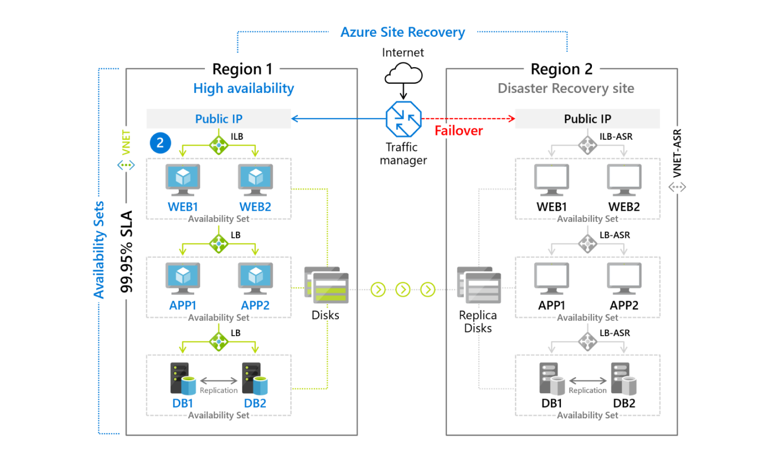
Azure Site Recovery

Slide 44

VM Scale Sets

Slide 45
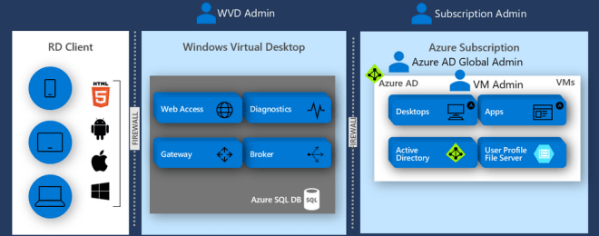
Windows Virtual Desktop (WVD)
timw.info/travis

Slide 46

Availability Zone

Slide 47

VM Networking

Slide 48
SQL Failover Groups
Auto-failover across regions
Read-write and read-only endpoints
Grace period for data loss configuration
Use listener endpoint, not server name
Application connection string pattern

Slide 49
Storage HA Patterns
RA-GRS: Read access to secondary region
Customer-managed vs Microsoft-managed failover
Soft delete for accidental deletion recovery
Point-in-time restore for blob data
Immutable storage with legal hold

Slide 50
Composite SLA Calculation
Single VM Premium SSD: 99.9%
Availability Set: 99.95%
Availability Zones: 99.99%
Multiply SLAs for dependent services
Add redundancy to improve composite SLA

Slide 51
Exam Tips - Segment 3
RPO = data loss time, RTO = downtime
Avail Sets = rack/power, Zones = datacenter
Backup vault and ASR both use Recovery Services vault
SQL failover: use .database.windows.net listener
GRS failover: customer-managed = you initiate

Slide 52
Segment 4: Compute & App Architecture

Slide 53
Segment 4 Learning Objectives
Design compute solutions
Design an application architecture
Recommend messaging and event-driven architecture
Recommend solutions for API integration
Recommend caching and configuration solutions

Slide 54
Compute Decision Tree
Lift-and-shift, full OS control: VMs + VMSS
Microservices, some orchestration: Container Apps
Complex orchestration, K8s expertise: AKS
Event-driven, short-lived: Functions Consumption
HPC, batch rendering: Azure Batch

Slide 55

Load Balancing

Slide 56
Container Options Decision Matrix
ACI: Simple workloads, batch, sidecar
Container Apps: Microservices, Dapr, KEDA scaling
AKS: Full K8s control, complex orchestration
Web App for Containers: Simple web apps
Container Apps = simplicity + Dapr, AKS = full control

Slide 57
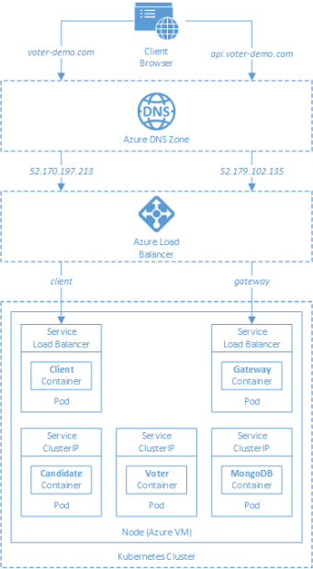
AKS

Slide 58

Azure Backup

Slide 59
Azure Container Apps
Managed Kubernetes-based platform
Built-in Dapr integration for microservices
KEDA-based autoscaling (HTTP, queue, custom)
Revisions for blue-green deployments
Managed identity and secret management

Slide 60
Azure Functions Patterns
Consumption: Auto-scale to zero, pay per execution
Premium: VNet integration, no cold start
Dedicated: Predictable cost, always warm
Durable Functions for stateful workflows
Triggers: HTTP, Timer, Queue, Event Grid, etc.

Slide 61
Messaging Decision Matrix
Service Bus Queues: Point-to-point commands
Service Bus Topics: Pub/sub with filtering
Event Hubs: High-throughput streaming, telemetry
Event Grid: Reactive event routing, webhooks
Service Bus = transactions, Event Grid = events

Slide 62

Event Architecture

Slide 63
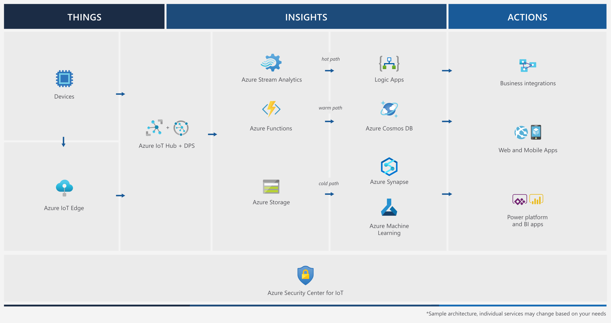
Event Architecture

Slide 64
API Management
Consumption tier: Serverless, pay-per-call
Developer/Standard/Premium: Dedicated capacity
Policies: JWT validation, rate limiting, caching
Developer portal for API documentation
VNet integration with Premium tier

Slide 65
Azure Cache for Redis
Cache-aside pattern implementation
Clustering for >53GB and horizontal scaling
Geo-replication for DR
Data persistence options
Connection resiliency patterns

Slide 66
App Configuration
Centralized configuration management
Feature flags for controlled rollouts
Key Vault references for secrets
Labels for environment separation
Configuration refresh with sentinel keys

Slide 67
Exam Tips - Segment 4
Container Apps vs AKS: Apps = simple, AKS = control
Functions: Consumption = auto-scale, Premium = VNet
Service Bus = commands, Event Grid = events
Event Hubs partitions: cannot increase after creation
Redis clustering: required for >53GB

Slide 68
Segment 5: Networking & Migrations

Slide 69
Segment 5 Learning Objectives
Design network solutions
Design migrations using Cloud Adoption Framework
Recommend connectivity solutions
Recommend load-balancing and routing solutions
Recommend solutions for migrating databases

Slide 70
Network Topology Patterns
Hub-Spoke: Central hub VNet with peered spokes
Virtual WAN: Managed hub for >10 spokes, SD-WAN
Network Virtual Appliances for advanced routing
User-defined routes for forced tunneling
Azure Firewall for centralized security

Slide 71
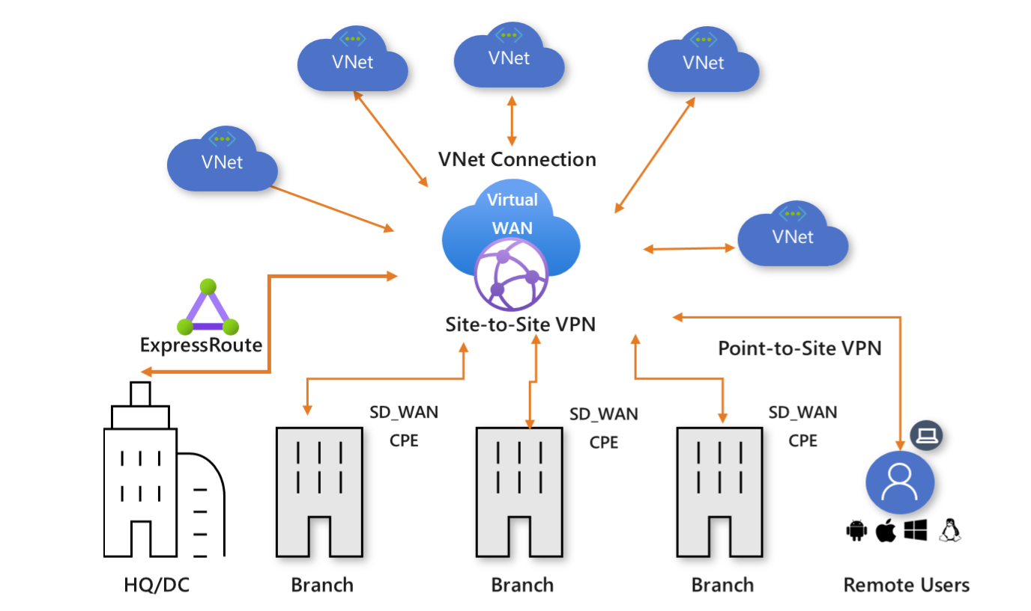
Azure Virtual WAN

Slide 72
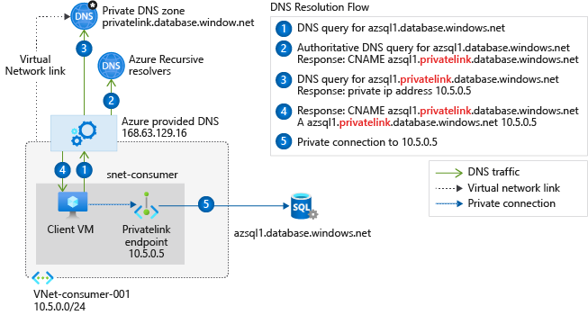
Private Link DNS Configuration

Slide 73

Network Virtual Appliance

Slide 74
Azure Backup

Slide 75
Network Security Decision Matrix
NSG: L4 stateful filtering, distributed
Azure Firewall: Centralized, FQDN filtering, L7
App Gateway WAF: Web application protection
Front Door WAF: Global edge protection
ASG: Microsegmentation for application tiers

Slide 76

VNet Peering

Slide 77

Traffic Manager

Slide 78


Docker Container Lifecycle
https://timw.info/3635f

Slide 79

Front Door Service

Slide 80
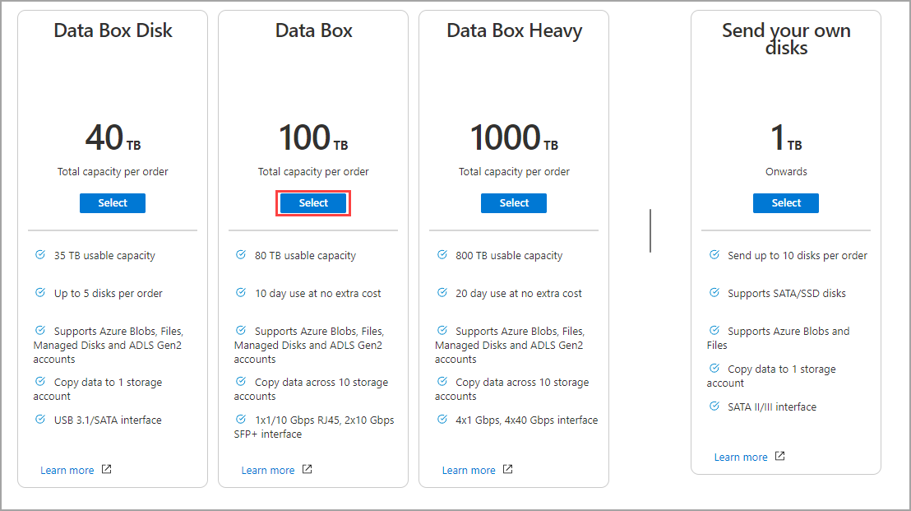
Azure Data Box

Slide 81
CAF Migration Phases
Strategy: Define business outcomes
Plan: Rationalize digital estate
Ready: Create landing zones
Migrate: Assess, deploy, release
Innovate and Govern: Optimize and secure

Slide 82
Exam Tips - Segment 5
Hub-spoke vs vWAN: vWAN for >10 spokes, SD-WAN
ExpressRoute = private, VPN = over internet
Private Link = private IP, Service Endpoints = route
Azure Firewall = central, NSG = distributed
Front Door = CDN+WAF, Traffic Manager = DNS only

Slide 83
Cross-Cutting Themes
Well-Architected Framework: 5 pillars
Reliability, Security, Cost Optimization
Operational Excellence, Performance Efficiency
Apply to every design decision
Exam expects WAF reasoning in answers

Slide 84
Zero Trust Architecture
Verify explicitly: Authentication everywhere
Use least privilege: Scoped RBAC
Assume breach: Network segmentation
Encrypt data in transit and at rest
Monitor and audit everything

Slide 85
Managed Identity Pattern
System-assigned: Tied to resource lifecycle
User-assigned: Independent lifecycle, shareable
No secrets to manage or rotate
Works with Key Vault, Storage, SQL, Service Bus
Always prefer over service principals with secrets

Slide 86

Multiple Choice

Slide 87
Repeated Scenario
You need to move an Azure VM to another hardware host.
Solution: You redeploy the VM.
Does this solution meet the goal?
Yes
No

Slide 88






Performance-Based Lab

Slide 89
AZ-305 Exam Strategy
Focus your skills accordingly:
60 percent Azure portal
20 percent Azure PowerShell
10 percent Azure CLI
10 percent KQL
Expect performance-based labs, but be thankful if you don't see 'em

Slide 90
Post-Course Resources
Practice Assessment: aka.ms/az305practice
Exam Sandbox: aka.ms/examdemo
Azure Architecture Center
Well-Architected Framework
Cloud Adoption Framework

Slide 91
Recommended Next Steps
Review this course's companion repo
Practice with Azure free tier or sandbox
Take the official practice assessment
Schedule your exam within 2 weeks
Good luck on your certification journey!

Slide 92

Azure Monitor

Slide 93
Tim Warner
Based in Nashville, TN, US
28-year Microsoft Certified Trainer (MCT)
6-year Microsoft MVP in Azure AI
Contact: TechTrainerTim.com

